Slide 1
Classifying ASL Fingerspelling with Deep Learning
Owen Mccormack

Slide 2
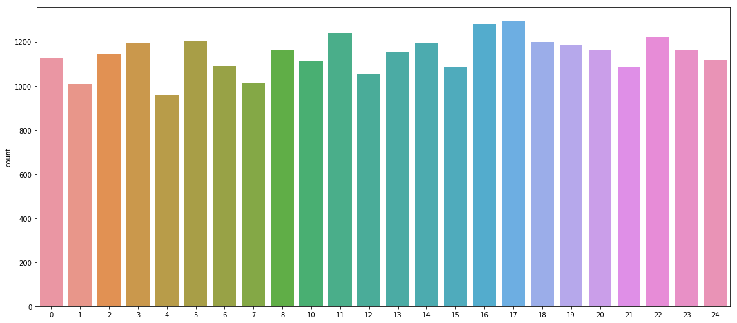
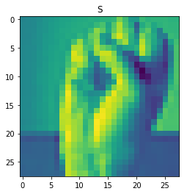
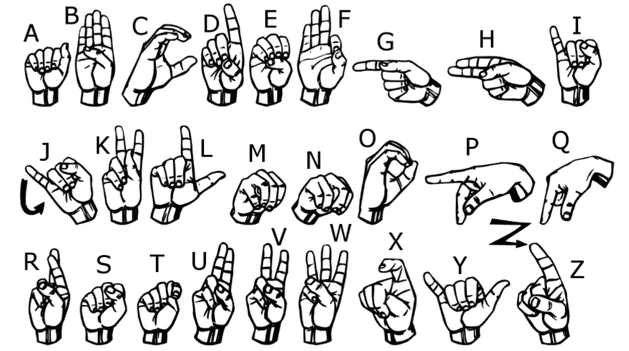
Recap
Interested in Sign Language Recognition
Classify ASL letters from 28x28 sets of pixels
Dataset originally from 2018 Kaggle challenge
Dataset included over 27,000 images for training, over 2000 for testing

Slide 3


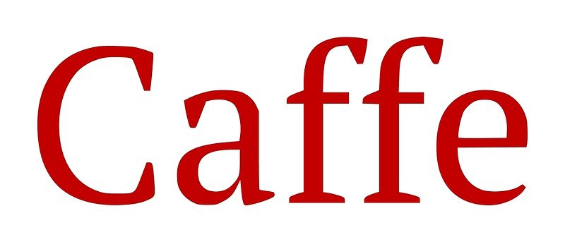
My Approach
Used PyTorch as Deep Learning Framework
Convolutional Neural Network with 7 hidden layers
3 Convolution Layers, 2 Max-Pool Layers, and 2 Fully Connected Layers

Slide 4
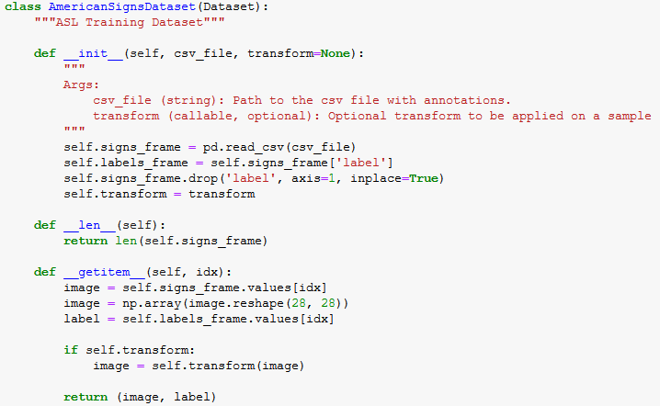
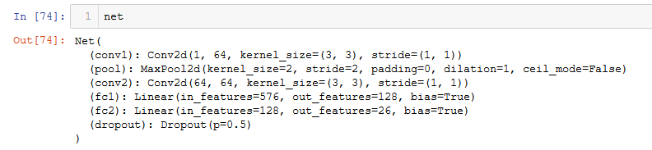
PyTorch Setup
Dataset class to access labels and image for each minibatch
3 different DataLoaders: train, validation, test
80/20 training validation split
Network architecture defined in forward function of net class

Slide 5
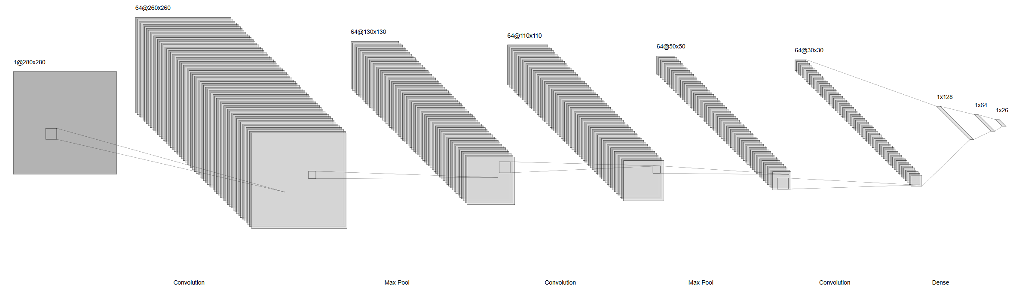
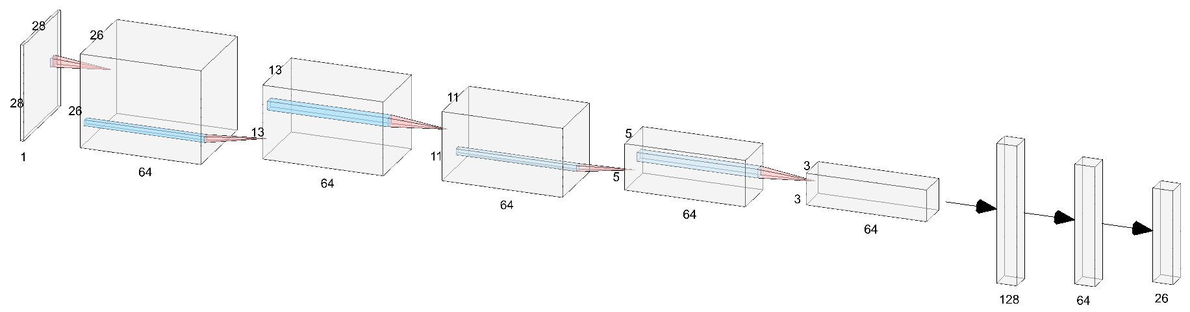

Slide 6
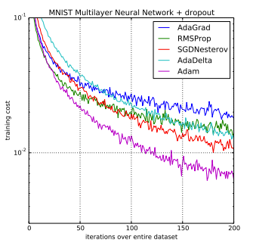
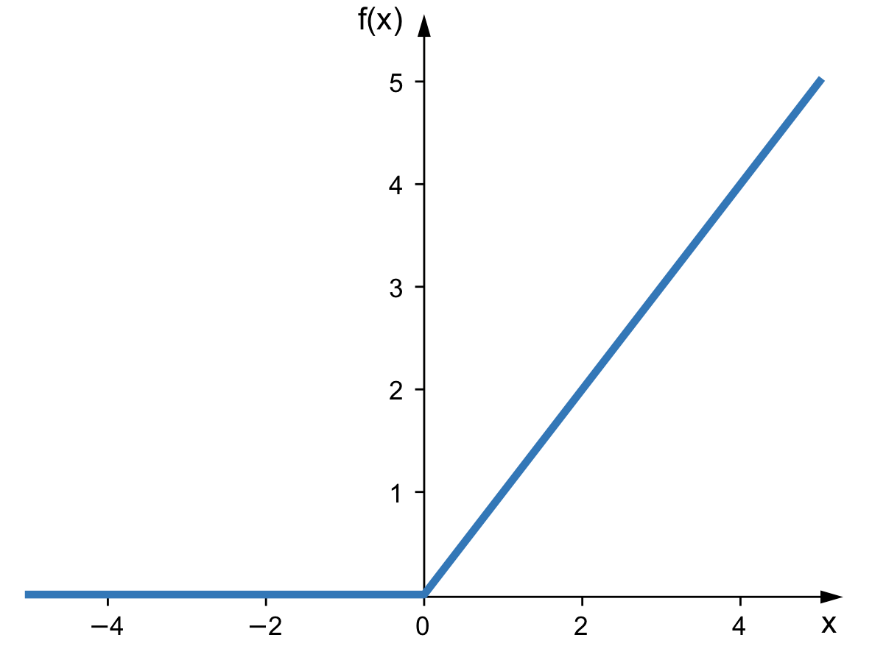
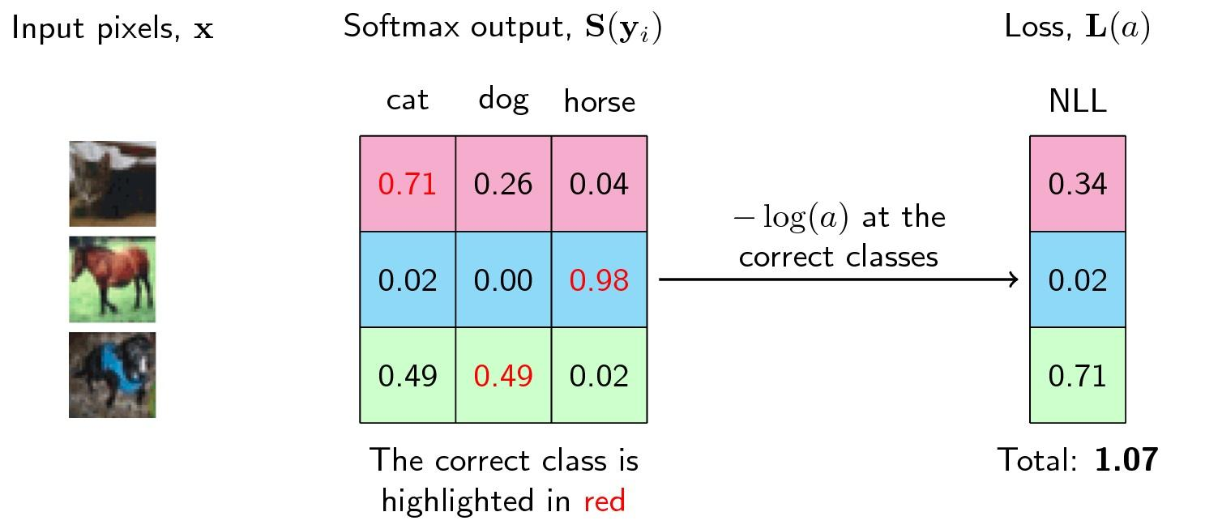
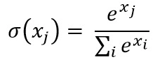
Learning Process
ReLU activation applied after every CONV layer
Cross Entropy loss which uses combination of Softmax and negative log likelihood
Stuck with Adam for optimization after getting better results than standard SGD

Slide 7
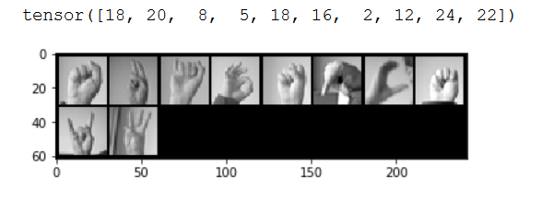
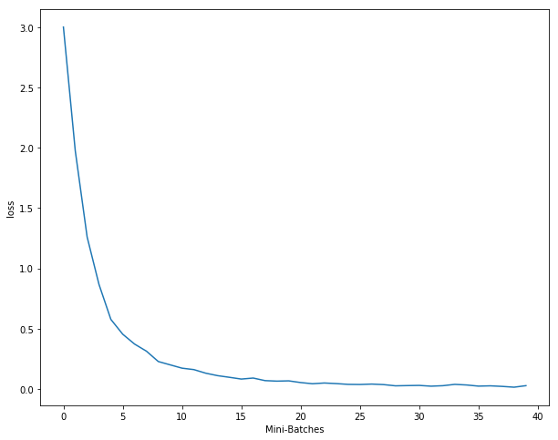
Learning Process(cont.)
Validation set broken off of training data
Network ran on GPU for 20 epochs in mini batches of 10 with learning rate 0.0001
Dropout was applied in final layer to reduce overfitting

Slide 8
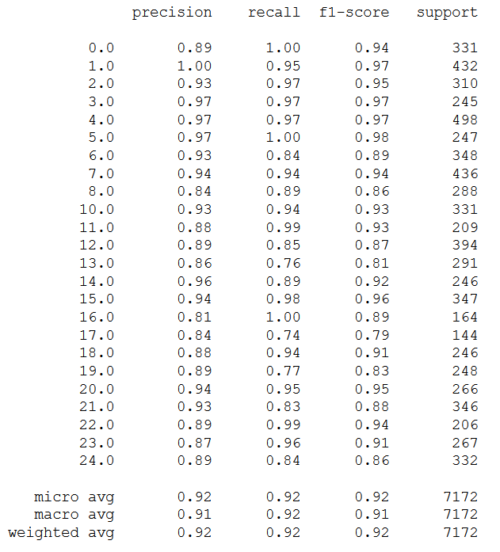

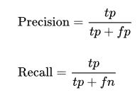

Results
About ~92% accuracy on test set
Classification report and confusion matrix show results
https://youtu.be/v--gpwu29IQ

Slide 9
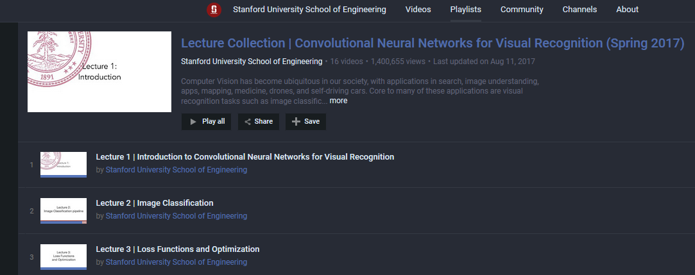

Lessons Learned/Regrets
Wanted to get webcam hand recognition for live demo
Lots of time was spent understanding deep learning and then getting a network actually working

Slide 10
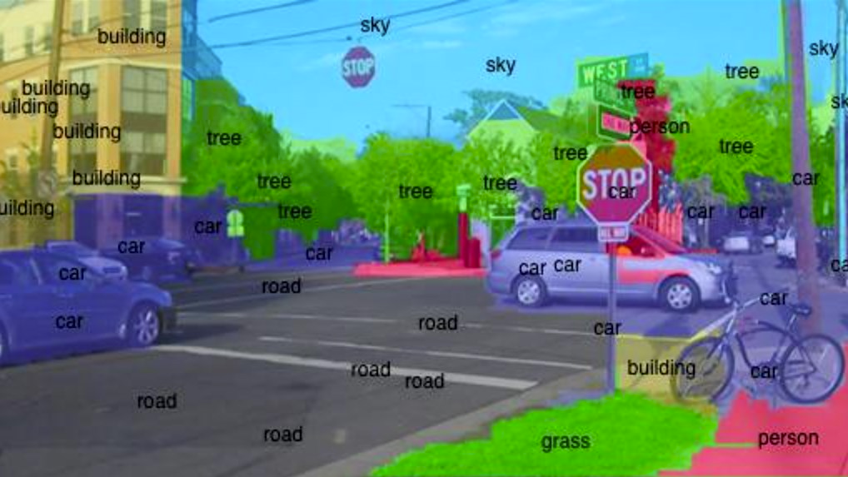
Conclusions
Deep Learning is very powerful and relatively easy to implement
Computer Vision applications are countless and cover many important areas
Questions?

